Slide 1

Reframing Healthcare
A 10 to 15 years Outlook
Notes:
Hello my name is Yatza and will be going through
the outlook of our future healthcare system.
To understand where healthcare is heading in the next 10-15 years, we first need to understand the limitations of system today.
By identifying these gaps and pain points, we can better envision a healthcare system designed around health rather than healthcare utilization.
While Dr. Neuwirth's Beyond the Walls focuses on the positive transformation already underway, he argues that many of the United States' healthcare challenges remain rooted in legacy policies and outdated business models

Slide 2



Legacy Framework
Fee-for-service (FFS) reimbursement rewards volume over outcomes
Hospital-centric, brick-and-mortar delivery model
Limited integration of social and contextual determinants of health
High costs with inconsistent patient outcomes
Notes:
Fee-for-service reimbursement incentivizes the volume of healthcare services rather than improving health outcomes.
Hospital-based systems require significant fixed operating costs, creating financial pressure to maintain high service volumes.
The traditional model of healthcare, which focuses primarily on treating medical conditions, often overlooks the social and contextual factors that drive health outcomes.
With rising healthcare costs and a growing shortage of clinicians, we must restructure not only our healthcare system but also our mindsets.
Our goal should be to build a healthier society that supports people every day—not just when they are sick.

Slide 3

Eliminating Barriers
Literal
  Provide Virtual, Digital, and Automated Care
  Reframe Point of Need is Point of Care
  Home-based Care Ecosystem
Conceptual
  Diversity, Equity, and Inclusion
  Identify and address non-clinical determinants of health
  Customized health addressing contextual concerns with whole health care focus system
Systematic
  Use of platforms powered by the “Network Effect”
  Create Partnerships, Collaborations and Integrations with other systems and industries
  Reframe Payments and policy reform beyond fee for service (FFS)
Notes:
To facilitate a proactive approach to medicine, we need to eliminate barriers in three key domains: Literal, Conceptual, and Systematic.
Literal
Literal barriers focus on resolving health inequity problems.
By making access to care less cumbersome through virtual care, digital communication, and text-based support.
Automating routine patient questions can reduce administrative burden on clinicians, allowing them more time with their patients.
Conceptual
Conceptual barriers stem from traditional healthcare were the focus is on treating illness instead of addressing the whole person. To elevate care management we need to evaluate patients' social environments, relationships, and daily living conditions.
We need to become more inclusive and diversify the way we evaluate health and provide services that extend beyond medicine and feed the spirit as well as the body.
Systematic
Finally, the systematic barrier is our continued reliance on fee-for-service reimbursement, which does not scale well during times of crisis.
Eliminating this barrier requires grit and determination to go beyond traditional merger and acquisitions to create new systems of partnerships that are non-traditional, patient-centered platforms.
Building platforms that connect patients, clinicians, community organizations, and technology partners creates a sustainable ecosystem that continuously improves health outcomes.

Slide 4
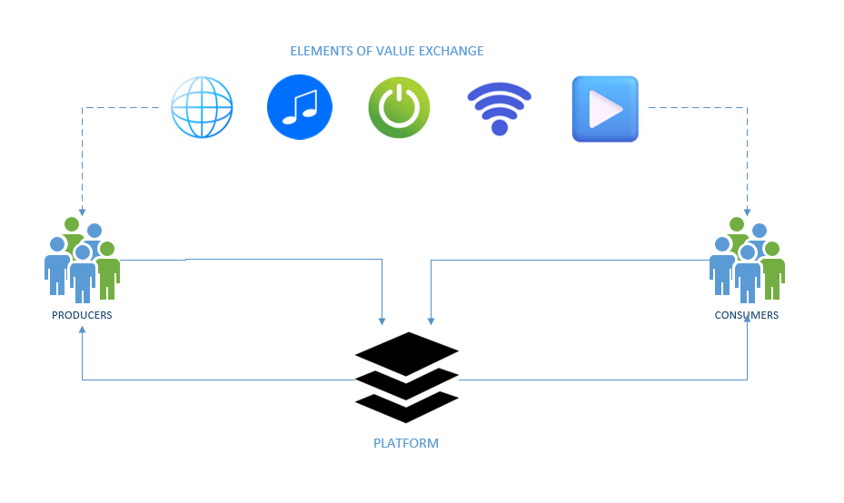
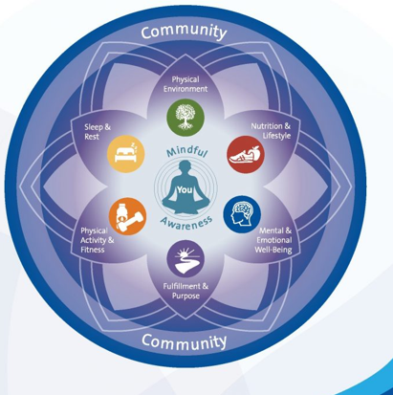

Whole Person Humanized Health
Value-based & Direct to Employer Plans
Adopt “Flywheel” model to fostering customer daily habit
Create platforms facilitating “Network Effect” empowering consumerism
Enable ease of access to care 24/7 model supporting home-based ecosystems and virtual care
Health system partnerships that expanding vertically (contextual, emotional, spiritual, and SDOH)
Focus on whole personal health and wellness
Notes:
So what does the future hold in healthcare?
We are moving toward a more human-centered, whole-person healthcare system.
Reducing waste by simplifying our payment system through models such as Medicare Advantage for value-based reimbursement and the Direct To Employer (DTE) plans to allow our hospital-based systems to expand their network and care beyond payer relationships.
We're already seeing many hybrid healthcare organizations adopt platform and flywheel strategies to improve patient engagement and, ultimately, health outcomes.
They have also created sophisticated AI-enabled digital platforms that support continuous monitoring, personalized recommendations, and proactive care.
Future healthcare organizations will function as intelligent platforms rather than isolated facilities. By combining clinical information with behavioral, environmental, and social data, these systems will personalize care for each individual while continuously learning from every interaction.
Many organizations are expanding vertically by integrating pharmacy, primary care, behavioral health, home health, and digital services into a single care ecosystem.
According to the County Health Rankings model
clinical care only accounts for (20%)
social and economic factors (40%)
environmental factors (10%)
and behavior (30%).
This means approximately 80% of a person's health outcomes are influenced by factors outside traditional clinical care.

Slide 5


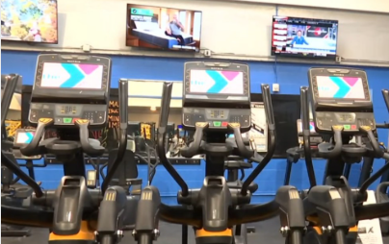


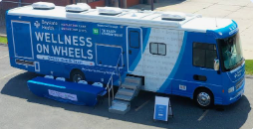

Where to find Care?
Home
  TV
  Mobile devices
  Refrigerator
  Home Devices (Echo, Google Nest, Apple Home)
Community
  At the Gym
  Mobile care centers
  At the workplace
Notes:
So Where will we find care in the future?
Healthcare services will become fully ingrained with our daily habits -
Throughout the home with the aid of mobile devices, wearables, TVs, and even refrigerators!
Smart home technologies—including voice assistants and connected home sensors—
will increasingly support preventive care and chronic disease management.
In addition to the home, there will also be expanded services that will facilitate healthier habits within the community.
Bringing healthcare directly to targeted populations through workplaces, community centers, schools, gyms, and mobile clinics you name it.

Slide 6



Healthcare Synergies
Best Buy – Atrium Health
Humana – CenterWell
United Health Group – Optum and Change Health
CVS – Aetna
Uber – Uber Health
Amazon – Amazon Pharmacy & Amazon Care
Walgreens – VillageMD-Summit Health-CityMD, & CareCentrix
Walmart – Healthcare Services Super Center
Local Hospital Brands – Venture Capitalist and other hospital brand partnerships
Notes:
And so the future of healthcare seems optimistic, but we still need to be cautious with merger & acquisitions and partnerships
While the larger systems like Humana, Amazon, and United Health have greater financial resources and a larger margin for experimentation,
they still need to adapt to the healthcare industry and remain vigilant with compliance and user's feedback.
Smaller health systems may face increasing financial pressure unless they adopt collaborative partnerships, with digital capabilities, or alternative value-based business models.
They will also need strategic partnerships with technology companies, investors, or even former competitors to remain financially sustainable.
These are the new concerns we will face in healthcare.

Slide 7
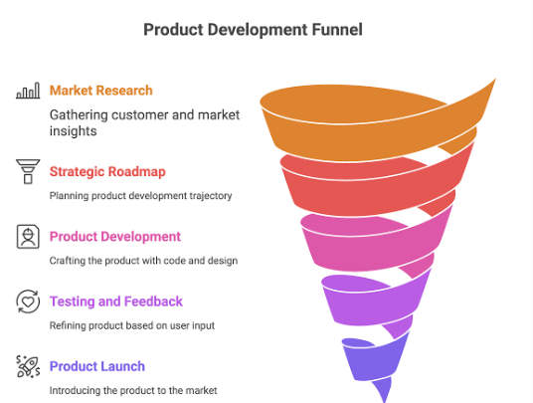
Who Delivers Care?
Healthcare disrupter that can provide support for all wellness needs with whole person health mindset.
Systems that reframe the health industry from sick-care to healthcare.
Systems that are focused on the customers needs and has a healthy feedback loop that will elevate healthcare outcomes and inequities
Notes:
This leads to the question of who will deliver care to our future patients?
The most resilient healthcare systems will be those that keep the patient's overall health at the heart of all their decision.
Leaders who can shift healthcare toward proactive, preventive, and minimally invasive care will build systems that improve outcomes through continuous innovation.
Highly customizable digital platforms that combine clinical, behavioral, environmental, and exposome data will deliver increasingly personalized care. These systems will continuously learn from every patient interaction, empowering individuals to actively manage their own health.
Organizations that successfully integrate healthcare with technology, retail, employers, and community services will become the primary coordinators of care.

Slide 8
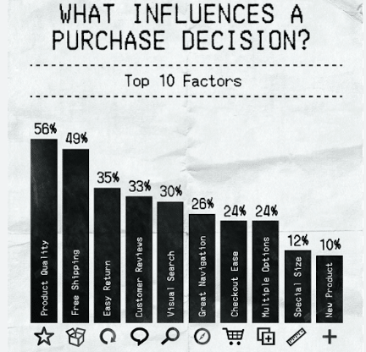
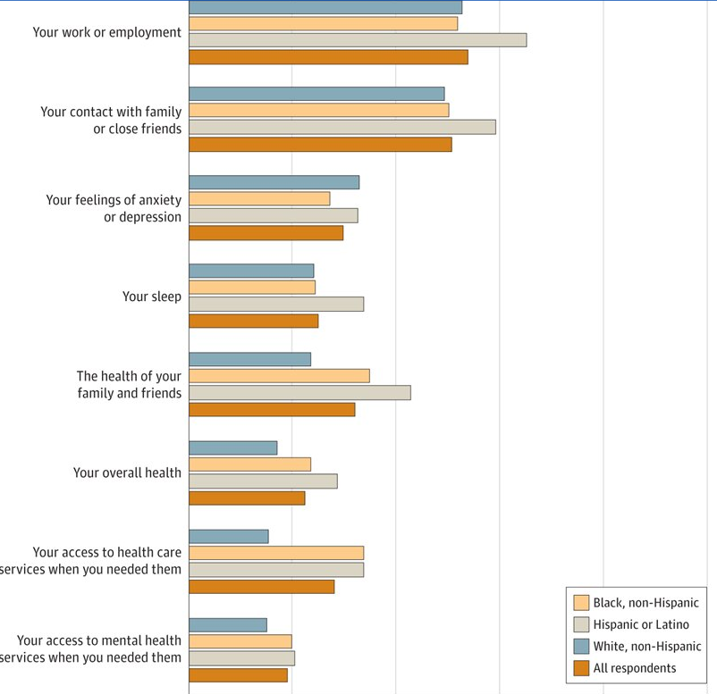

How to measure success?
Patient outcomes
Product Quality & Customer Satisfaction
Patient Experience
Costs
Notes:
Now that we've explored where care will be delivered and who will deliver it, how do we measure success?
We measure by
patient outcomes
Reduced hospital readmissions
Lowered emergency department utilization
Patient satisfaction
impact on quality of life
Digital engagement
Sustainable platform growth
Lower total cost of care
How will we know we have created a successful healthcare platform that attracts not only patients but also providers and community partners?
Success will be measured primarily through improved patient outcomes, reduced hospital readmissions, fewer emergency department visits, patient satisfaction ratings, the way it impacts our quality of life and healthier populations.
A Platform network effects will be indicators of organizational success.
And finally lower total cost of care

Slide 9
References
Beyond the Walls: Megatrends, Movements, and Market Disruptors Transforming American Healthcare. Neuwirth ZE. Beyond the Walls: Megatrends, Movements, and Market Disruptors Transforming American Healthcare. Advantage Media Group; 2023.
Craig KJT, Fusco N, Gunnarsdottir T, Chamberland L, Snowdon J, Kassler W. (2021). Leveraging data and digital health technologies to assess and impact social determinants of health (SDoH). Online Journal of
Sieck, C. J., Sheon, A., Ancker, J. S., Castek, J., Callahan, B., & Siefer, A. (2021). Digital inclusion as a social determinant of health. NPJ Digital Medicine, 4(1), 52.
Benjamin, GC. (2023). The future of public health: Ensuring an adequate infrastructure. The Milbank Quarterly, 101(S1), 637-652.
Notes:
Thank you for watching my presentation. I hope this discussion provided insight into how value-based care, digital health, and patient-centered innovation may reshape healthcare over the next 10 to 15 years.
This slide contains the references used in this presentation.

